Slide 1
The Compilation Power – C++
Basic Knowledge
Compilation is the stage which makes your code executable. It is the translation process, done by the compiler, from your coding language to a machine language (aka binary.)
Note: For this presentation I’ll use the Gnu Compilers Collection compiler (aka GCC.)

Slide 2
C++ Metaprogramming
Templates (Type / Value arguments.)
Template Argument Restrictions:
Template-template.
Typename restrictions.
Requires (Since C++20)
Concepts (Since C++20)
Constexpr (Since C++11) & Consteval (Since C++20)
Concepts – More than just restrictions…

Slide 3
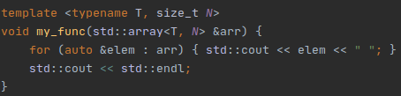
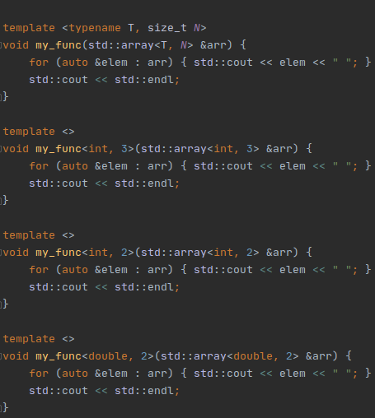
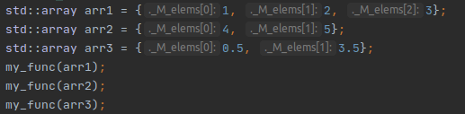
Templates Brief
Compile time auto generation for functions / classes which differed by compile time types / values parameters.
The compiler will generate the following functions for us:
// Language lawyers like me: Please ignore operator functions parsing.
With the following calls:

Slide 4
Template Argument Restrictions
Why?
Extended functionality (template-template).
Avoid developer mistakes.
- Let your code speak for itself.
- Protect your code from strangers.

Slide 5
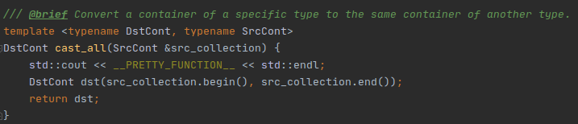

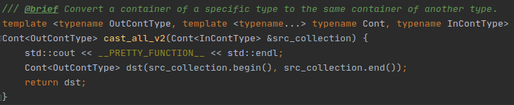

Template Argument Restrictions
Extended Functionality
With template-template we can gain an additional functionality when accessing a template-template argument.
All we want to specify on the call is the type to convert to:
The following implementation will allow us to do so:

Slide 6


Template Argument Restrictions
Typename Restrictions
One of the problems when using templates are the errors we can get on wrong usage. Using typename restrictions we can make sure on compile time to get more informative errors.
But who wants to create a legacy broken code that everyone hates? There have to be a better way to warn developers before they break down our beautiful code!
A pretty function which should sum all the arguments that passed to it and to return the result. On the best case, it’ll work:
Worst case, it won’t and we’ll get a very uncomfortable error that might lead to serious mistakes of our colleagues:
Worst case, it won’t and we’ll get a relatively informative error in the real source of the problem:

Slide 7
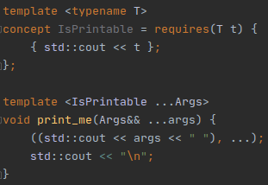
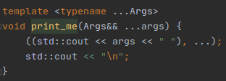


Template Argument Restrictions
Concepts Restrictions
As we saw before, restrictions are important to make our type compiler errors more clear and informative. In C++20 we got an opportunity to create get clear errors alongside a clear code. Now the templates can speak for themselves even for a coder who has a weak metaprogramming knowledge.
A pretty function which should print all the arguments that passed to it. On the best case, it’ll work:
Worst case, it won’t and we’ll get a very uncomfortable error that might lead to serious mistakes of our colleagues:
Worst case, it won’t compile and we’ll get a very clear error that will lead us to the root of the problem:

Slide 8
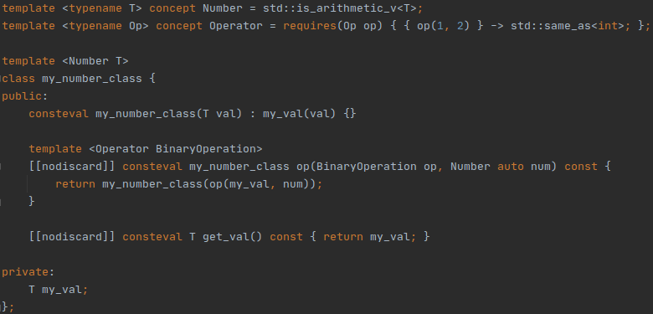
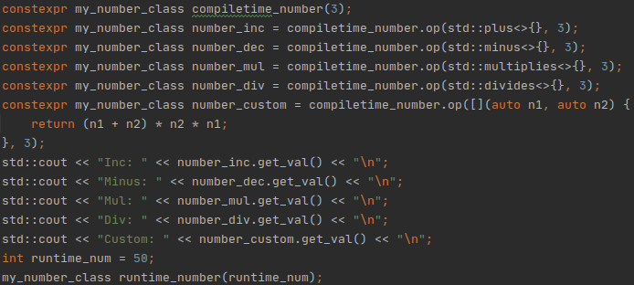
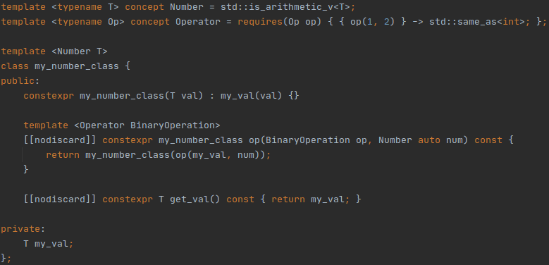

Constexpr & Consteval
Constexpr allows us to create large (possibly) compile time sections which might contain variables, conditions,
loops, classes and more! New C++ versions brought new abilities to this keyword, and C++20 brought us
for the first time the complete compile-time evaluation keyword: consteval.
The following class is a complete compile-time evaluation, defined using consteval. Any usage of this class
outside the compile time context, will lead to a compilation error:
The following class will be evaluated on compile time whenever the context will allow it, but
we also can make a runtime instance of it:
The following run time evaluation is allow alongside the compile time evaluations:

Slide 9
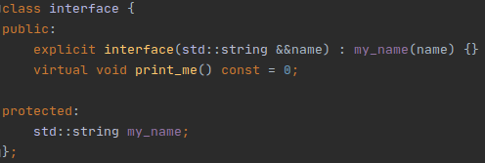
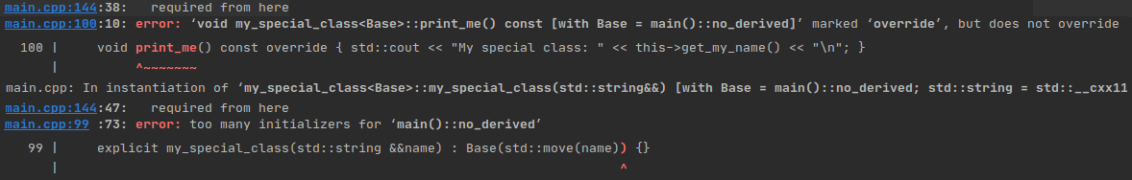
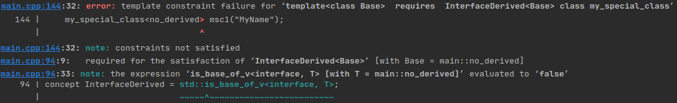
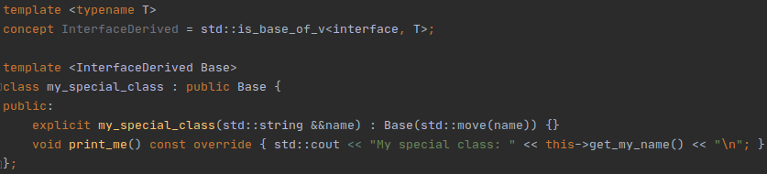
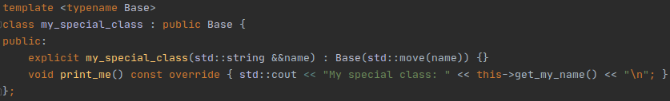
Back to Concepts
Concepts got a special attention in C++20 and made it possible to move more elements from the runtime evaluation to the compile-time evaluation. In additional for this, it made it possible to help the compiler know more specific details about our template parameters ahead- Even before we made the call for them.
And now the error we get from wrong usage:
With a wrong usage we’ll get a great compilation error, which will mark the class implementation as a mistake:
Take for example the following interface:
Assume we want to create a class which inherit from a template parameter that have to inherit this interface.
To fix this issue, and to be more clear at compile time, we can use concepts:

Slide 10
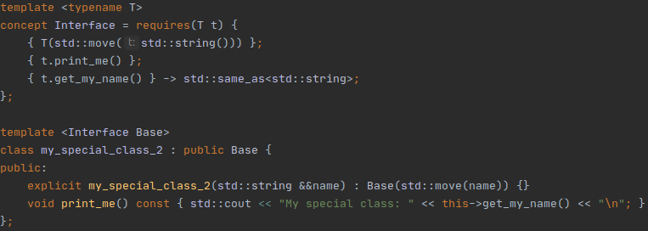

Concepts one step ahead
Interface Without Inheritance
Inheritance allows us to apply interfaces to different classes in order to allow a common functionality between them.
Concepts helps us to avoid unnecessary inheritance while keeping the common functionality:
You can also apply concept restrictions to auto variables:

Slide 11
Questions
If you have any questions, speak now or for ever hold your peace.
Or at least until you’ll be near
LinkedIn: /koralkashri
Mail: koralkashri@gmail.com
GitHub: /koralkashri
Twitter: @koralkashri

